Slide 1
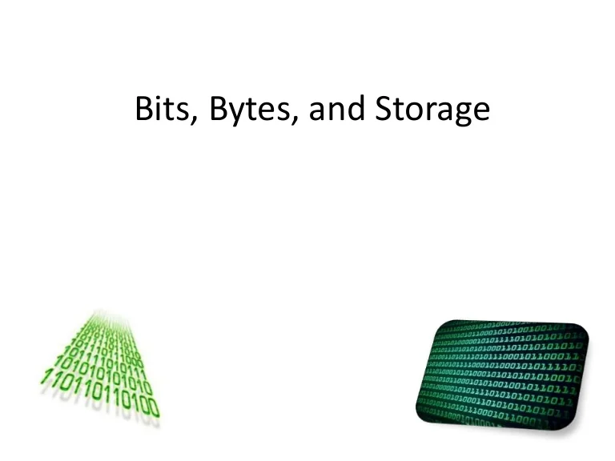
Karimova Zakhra, Hummatova Maryam
1459i

Slide 2
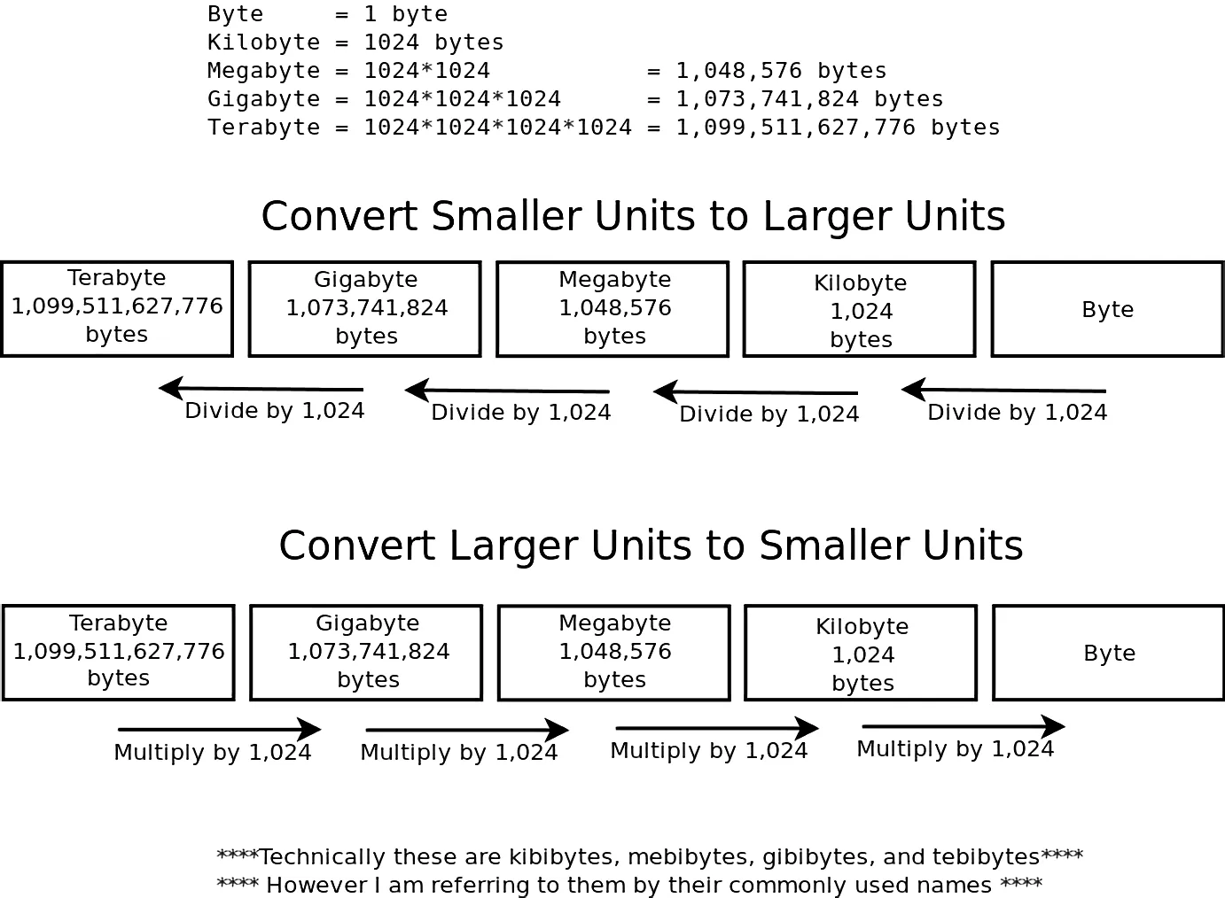

Slide 3
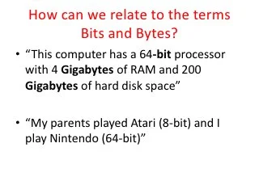

Slide 4
Byte (plural bytes)
The byte is a unit of digital information that most commonly consists of eight bits.
(computing) A short sequence of bits (binary digits) that can be operated on as a unit by a computer; the smallest usable machine word.
(computing, most commonly) A unit of computing storage equal to eight bits, which can represent any of 256 distinct values.
Synonyms: B, octet
The word “hello” fits into five bytes of ASCII code.
Byte denotes a group of bits used to encode a character, or the number of bits transmitted in parallel to and from input-output units. A term other than character is used here because a given character may be represented in different applications by more than one code, and different codes may use different numbers of bits (i.e., different byte sizes). In input-output transmission the grouping of bits may be completely arbitrary and have no relation to actual characters.

Slide 5
Derived terms
(unit of storage):
Compound words
Exabyte,gigabyte,kilobyte,megabyte,petabyte,terabyte,yottabyte,zettabyte
Coordinate terms
(unit of storage):
Previous: bit
Next: kilobyte
(machine word):
Previous: nybble
Next: word

Slide 6
The kilobyte is a multiple of the unit byte for digital information.
The International System of Units (SI) defines the prefix kilo as 1000 (10³); per this definition, one kilobyte is 1000 bytes. The internationally recommended unit symbol for the kilobyte is kB.
The megabyte is a multiple of the unit byte for digital information. Its recommended unit symbol is MB. The unit prefix mega is a multiplier of 1000000 (106) in the International System of Units (SI).
The gigabyte (/ˈɡɪɡəbaɪt, ˈdʒɪɡəbaɪt/) is a multiple of the unit byte for digital information. The prefix giga means 109 in the International System of Units (SI). Therefore, one gigabyte is one billion bytes. The unit symbol for the gigabyte is GB.

